Slide 1
Solution Approach
Use OBD-II data to monitor vehicle health.
Collect real-time sensor data using Raspberry Pi and OBD-II scanners.
Build machine learning pipelines to detect unusual patterns or predict faults.
Enable early alerts to prevent failure and optimize maintenance schedules.

Slide 2
Solution Approach
Use OBD-II data to monitor vehicle health.
Collect real-time sensor data using Raspberry Pi and OBD-II scanners.
Build machine learning pipelines to detect unusual patterns or predict faults.
Enable early alerts to prevent failure and optimize maintenance schedules.

Slide 3
Solution Approach
Use OBD-II data to monitor vehicle health.
Collect real-time sensor data using Raspberry Pi and OBD-II scanners.
Build machine learning pipelines to detect unusual patterns or predict faults.
Enable early alerts to prevent failure and optimize maintenance schedules.

Slide 4
Solution Approach
Use OBD-II data to monitor vehicle health.
Collect real-time sensor data using Raspberry Pi and OBD-II scanners.
Build machine learning pipelines to detect unusual patterns or predict faults.
Enable early alerts to prevent failure and optimize maintenance schedules.

Slide 5
Sprint 3 – Automation - Driving Behaviour Model – Predictive Maintenance Prototype
Integrated Raspberry Pi for automated data logging.
Triggered cloud uploads on Wi-Fi connection.
Developed dashboard with admin control over the cloud-based preprocessing pipeline on Hugging Face Spaces.
Built unsupervised model (K-Means clustering) to categorize driving behavior.
Feature engineered dataset.
Evaluated clusters against manually tagged sessions.
Testing and automation of clustering pipeline in progress.
Initial ML Prototyping for Predictive Maintenance
Perform EDA processing and data exploratories
Used SHAP to rank ENGINE_LOAD, AIRFLOW_PER_RPM etc
Labelled “MaintenanceNeed” via Isolation Forest (on high-stress values)
Trained Random Forest/XGBoost

Slide 6
Sprint 3 – Automation - Driving Behaviour Model – Predictive Maintenance Prototype
Integrated Raspberry Pi for automated data logging.
Triggered cloud uploads on Wi-Fi connection.
Developed dashboard with admin control over the cloud-based preprocessing pipeline on Hugging Face Spaces.
Built unsupervised model (K-Means clustering) to categorize driving behavior.
Initial ML Prototyping for Predictive Maintenance

Slide 7
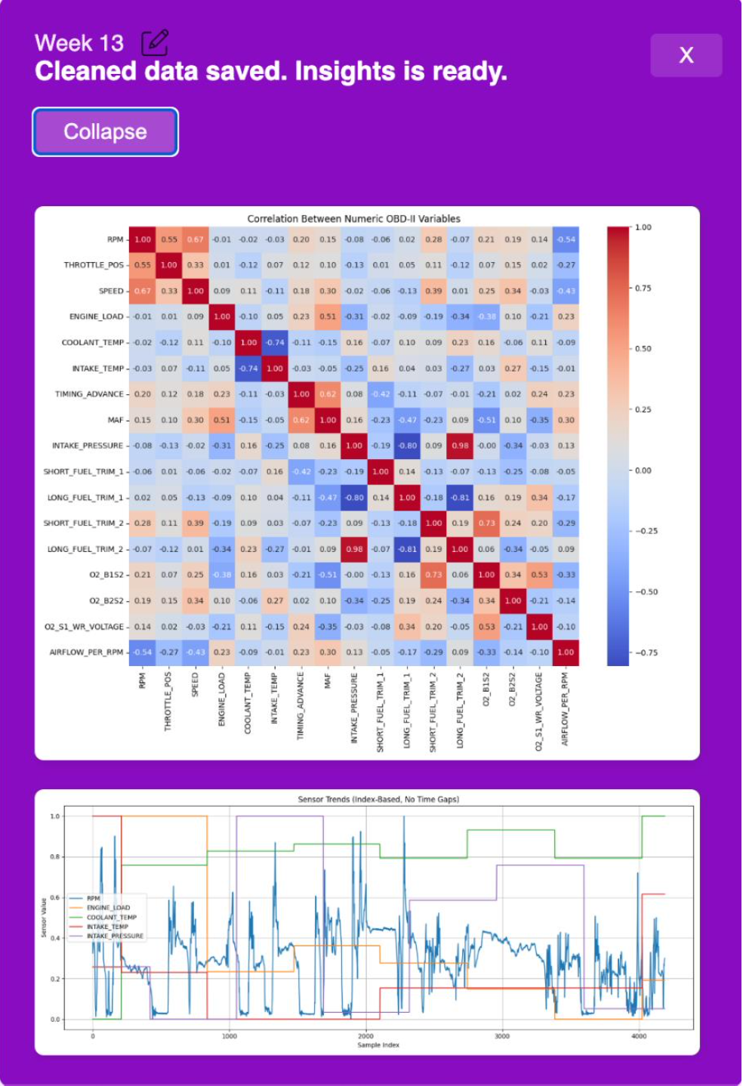
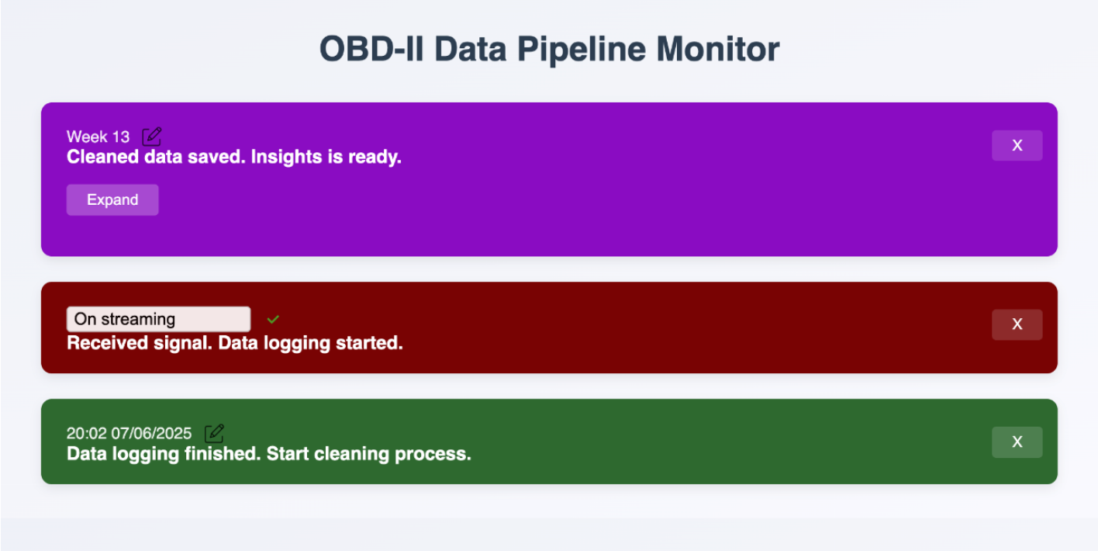
Web Accessible URL:
https://binkhoale1812-obd-logger.hf.space/ui

Slide 8
Sprint 3 – Automation - Driving Behaviour Model – Predictive Maintenance Prototype
Integrated Raspberry Pi for automated data logging.
Triggered cloud uploads on Wi-Fi connection.
Developed dashboard with admin control over the cloud-based preprocessing pipeline on Hugging Face Spaces.
Built unsupervised model (K-Means clustering) to categorize driving behavior.
Feature engineered dataset.
Evaluated clusters against manually tagged sessions.
Testing and automation of clustering pipeline in progress.
Initial ML Prototyping for Predictive Maintenance

Slide 9
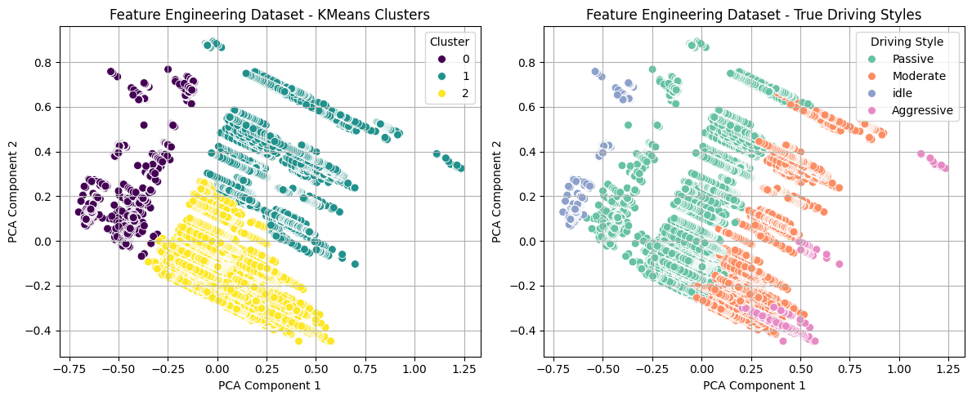
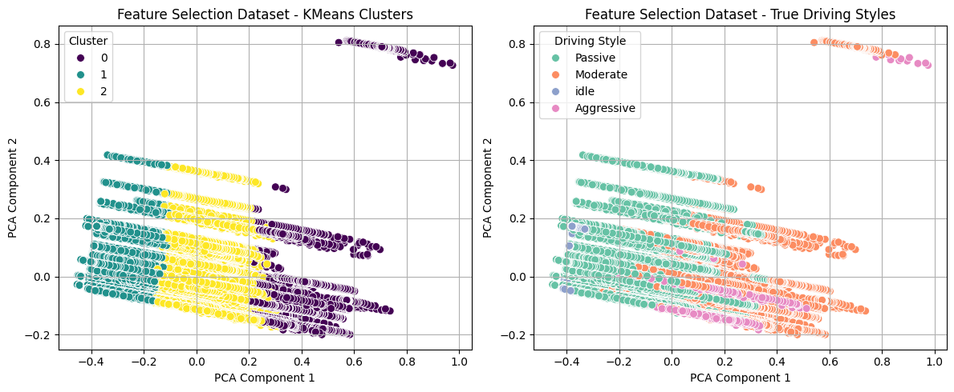

Slide 10
Sprint 3 – Automation - Driving Behaviour Model – Predictive Maintenance Prototype
Trained Random Forest/XGBoost
Integrated Raspberry Pi for automated data logging.
Triggered cloud uploads on Wi-Fi connection.
Developed dashboard with admin control over the cloud-based preprocessing pipeline on Hugging Face Spaces.
Built unsupervised model (K-Means clustering) to categorize driving behavior.
Initial ML Prototyping for Predictive Maintenance
Perform EDA processing and data exploratories
Used SHAP to rank ENGINE_LOAD, AIRFLOW_PER_RPM etc
Labelled “MaintenanceNeed” via Isolation Forest (on high-stress values)

Slide 11
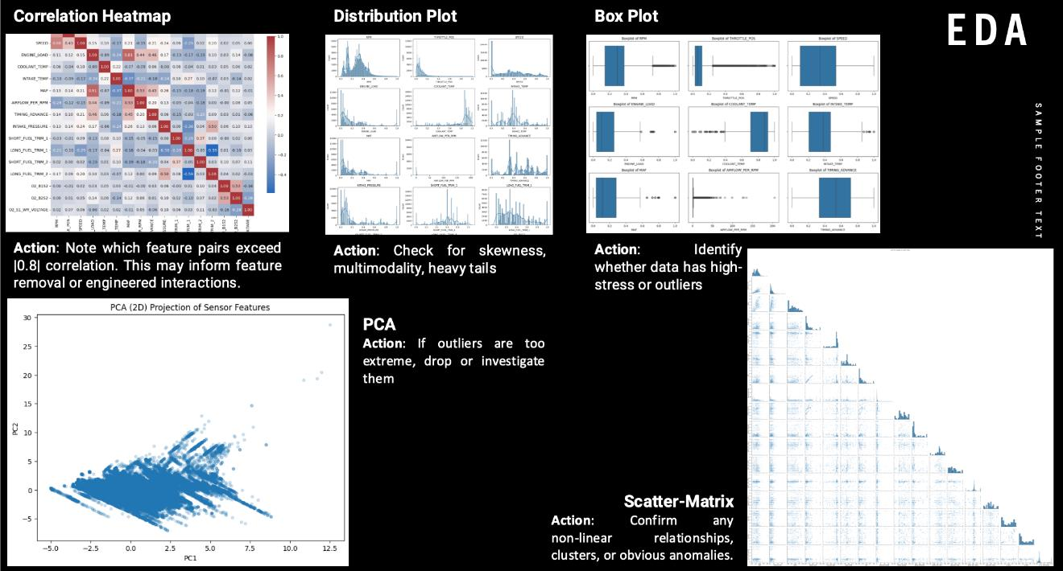
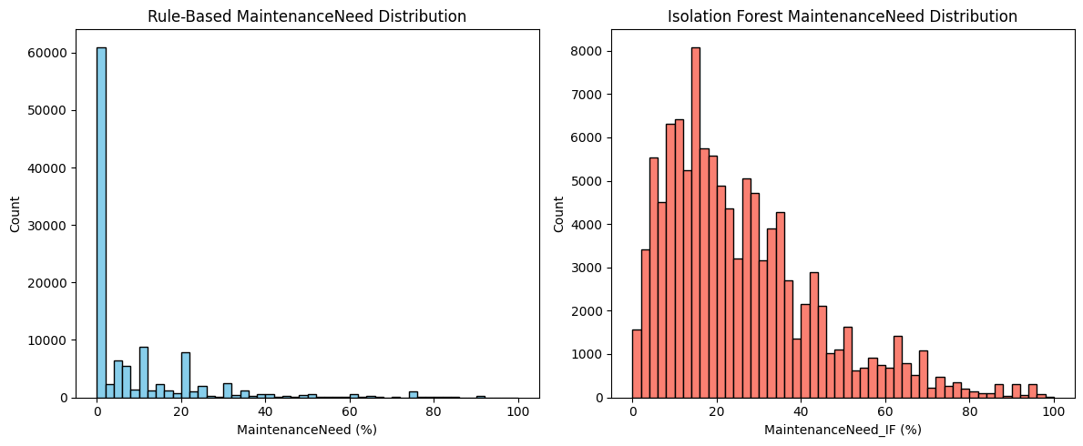
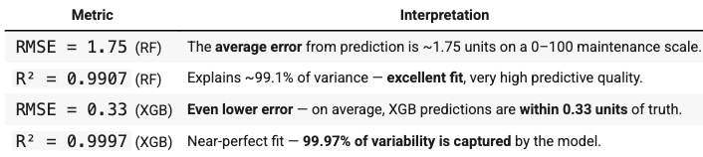

Slide 12
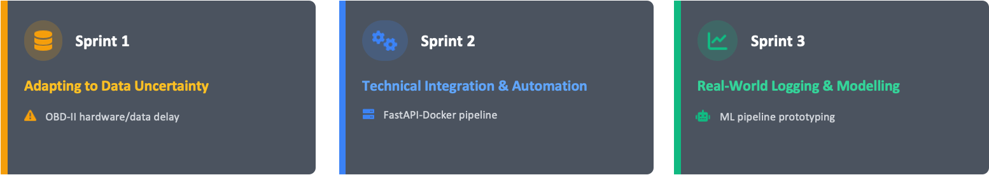
Reflection – Challenges & Solutions

